Slide 1

S.O.L.I.D
Object Oriented Design Principles

Slide 2

Introduction
S.O.L.I.D principles first introduced by Robert C. Martin in his 2000 paper Design Principles and Design Patterns although not by the acronym SOLID. The acronym was later introduced by Michael Feathers.
The aim is to have 5 design principles for creating understandable, flexible and maintainable software
While not directly related to each other, SOLID and design patterns share similar characteristics

Slide 3
The acronym
S - Single-responsibility principle (SRP)
O - Open-closed principle (OCP)
L - Liskov substitution principle (LSP)
I - Interface segregation principle (ISP)
D - Dependency inversion principle (DIP)

Slide 4
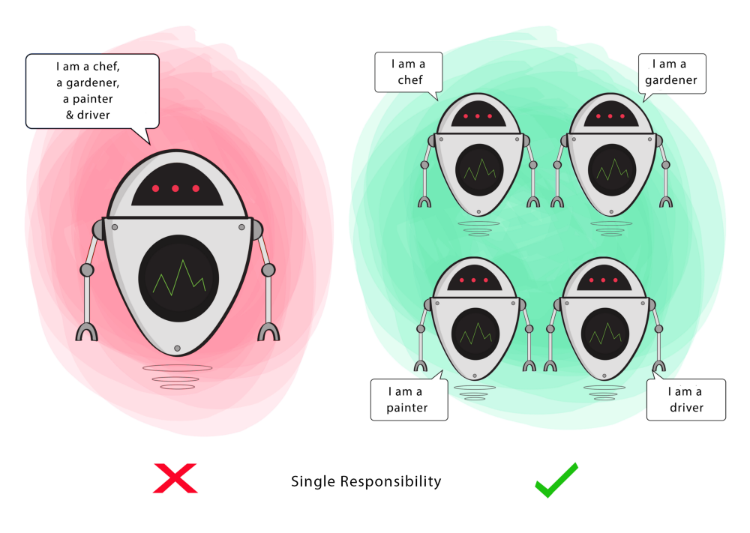
S - Single-responsibility principle (SRP)
“A class should only have a single responsibility, that is, only changes to one part of the software’s specification should be able to affect the specification of the class.”

Slide 5
Incorrect
class Shape {
public:
virtual double get_area() = 0; }; class Circle: public Shape {
private:
double radius;
public:
virtual double get_area() { return PI*radius*radius; }
};
class Square: public Shape {
private:
double side;
public:
virtual double get_area() { return side * side; }
};
class AreaCalculator {
private:
vector<Shape*> shapes;
public:
double total_area() {
double total = 0.0;
for (auto s: shapes) { total += s->get_area(); }
return total;
}
void output() {
cout << “Total area: “ << this->total_area() << endl;
}
};
Violates SRP

Slide 6
Create a new class with the output responsibility
class AreaOutputter {
public:
void JSON() {
// … Output logic for JSON
}
};
class AreaCalculator {
private:
vector<Shape*> shapes;
public:
double total_area() {
double total = 0.0;
for (auto s: shapes) { total += s->get_area(); }
return total;
}
};

Slide 7
Create an Abstract Base Class for output
class AreaOutputter {
public:
virtual double output() = 0; };
class JSONAreaOutputter : public AreaOutputter {
public:
virtual void output() { // … Output logic for JSON
}
};
class HTMLAreaOutputter : public AreaOutputter {
public:
virtual void output() { // … Output logic for HTML
}
};
class AreaCalculator {
private:
vector<Shape*> shapes;
public:
double total_area() {
double total = 0.0;
for (auto s: shapes) { total += s->get_area(); }
return total;
}
};

Slide 8
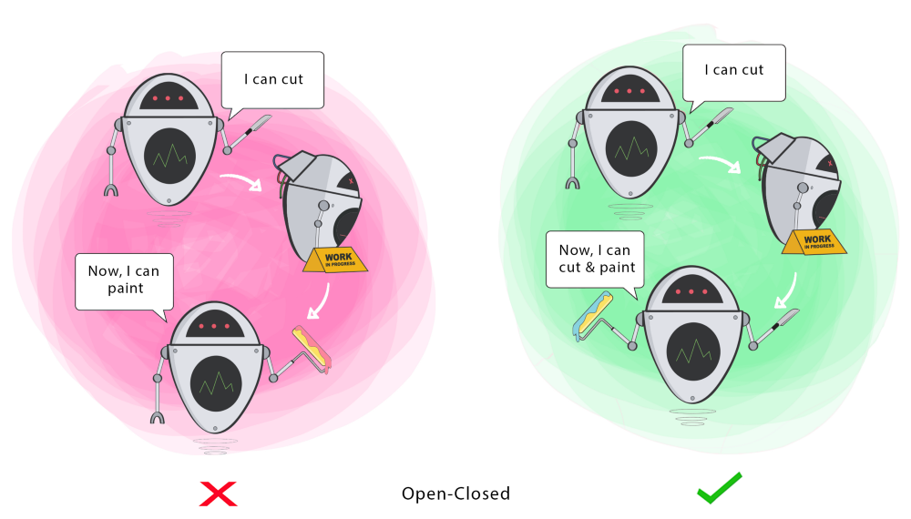
O - Open-closed principle (OCP)
“Software entities … should be open for extension, but closed for modification”

Slide 9
What’s wrong?
class AreaCalculator {
private:
vector<Circle*> circles;
vector<Square*> squares;
public:
double total_area() {
double total = 0.0;
for (auto c: circles) { total += (PI*pow(c->get_radius(),2)); }
for (auto s: squares) { total += (pow(s->get_side(),2)); }
return total;
}
};
class Circle {
private:
double radius;
public:
double get_radius() { return radius; }
};
class Square {
private:
double side;
public:
double get_side() { return side; }
};
If we want to add another shape, we need to modify AreaCalculator

Slide 10
Have AreaCalculator work with Shape
class AreaCalculator {
private:
vector<Shape*> shapes;
public:
double total_area() {
double total = 0.0;
for (auto s: shapes) { total += s->get_area(); }
return total;
}
};
class Shape {
public:
virtual double get_area() = 0; }; class Circle: public Shape {
private:
double radius;
public:
virtual double get_area() { return PI*radius*radius; }
};
class Square: public Shape {
private:
double side;
public:
virtual double get_area() { return side * side; }
};

Slide 11
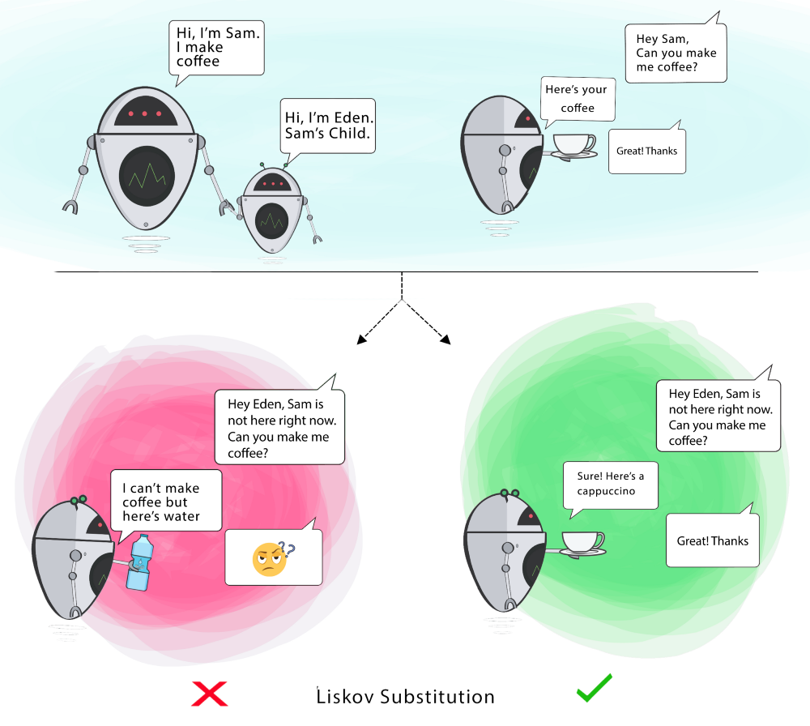
L - Liskov substitution principle
“Objects in a program should be replaceable with instances of their subtypes without altering the correctness of that program.”

Slide 12
Example of Liskov substitution principle violation
Suppose class Square inherits from class rectangle
If client code calls rectangle.setWidth(10), client does not expect rectangle to change length, but a square object will change both.
Hence, derived class cannot replace base class without altering client code correctness.
class Rectangle
protected:
double length;
double width;
public:
virtual void set_length(double l) { length = l;
}
virtual void set_width(double l) { width = l;
}
};
class Square: public Rectangle {
public:
virtual void set_length(double l) { length = width = l;
}
virtual void set_width(double l) { length = width = l;
}
};

Slide 13
class AreaCalculator {
private:
vector<Shape*> shapes;
public:
double total_area() {
double total = 0.0;
for (auto s: shapes) { total += s->get_area(); }
return total;
}
};
class VolumeCalculator {
private:
vector<Shape*> shapes;
public:
double total_volume() {
// Calculate the volume
return total;
}
};
Both are calculators but not related to each other (can’t replace one with the other)

Slide 14
Make both inherit from Calculator
class Calculator {
private:
vector<Shape*> shapes;
public:
virtual double total() = 0;
};
class AreaCalculator : public Calculator {
public:
virtual double total() {
double total = 0.0;
for (auto s: shapes) { total += s->get_area(); }
return total;
}
};
class VolumeCalculator: public Calculator {
public:
virtual double total() {
// Calculate the volume
return total;
}
};

Slide 16
Applying LSP to the Outputter class
class ValueOutputter {
public:
virtual void output() = 0; };
class JSONValueOutputter : public ValueOutputter {
public:
virtual void output() { // … Output logic for JSON
}
};
class HTMLValueOutputter : public ValueOutputter {
public:
virtual void output() { // … Output logic for HTML
}
};
class Calculator {
private:
vector<Shape*> shapes;
public:
virtual double total() = 0;
};

Slide 17
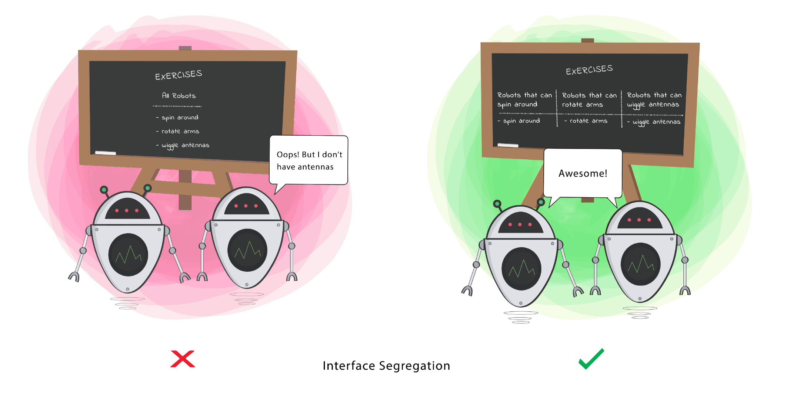
I - Interface segregation principle
“A client should never be forced to implement an interface that it doesn’t use, or clients shouldn’t be forced to depend on methods they do not use. ”

Slide 18
What’s wrong?
class Shape {
public:
virtual double get_area() = 0;
virtual double get_volume() = 0; };
class Circle: public Shape {
private:
double radius;
public:
virtual double get_volume() { // ???? }
};
class Square: public Shape {
private:
double side;
public:
virtual double get_volume() { // ???? }
};
Circle and Square have no volume

Slide 19
Add another class for shapes with volume
class Shape {
public:
virtual double get_area() = 0; }; class SolidShape : public Shape {
public:
virtual double get_volume() = 0; };
class Cuboid: public SolidShape {
private:
double length;
double width;
double height;
public:
virtual double get_volume() { // Calculate the volume }
virtual double get_area() { // Calculate the surface area }
};

Slide 20
Same but with multi-inheritance
class Shape {
public:
virtual double get_area() = 0; }; class SolidShape {
public:
virtual double get_volume() = 0; };
class Cuboid: public SolidShape,public Shape {
private:
double length;
double width;
double height;
public:
virtual double get_volume() { // Calculate the volume }
virtual double get_area() { // Calculate the surface area }
};

Slide 21
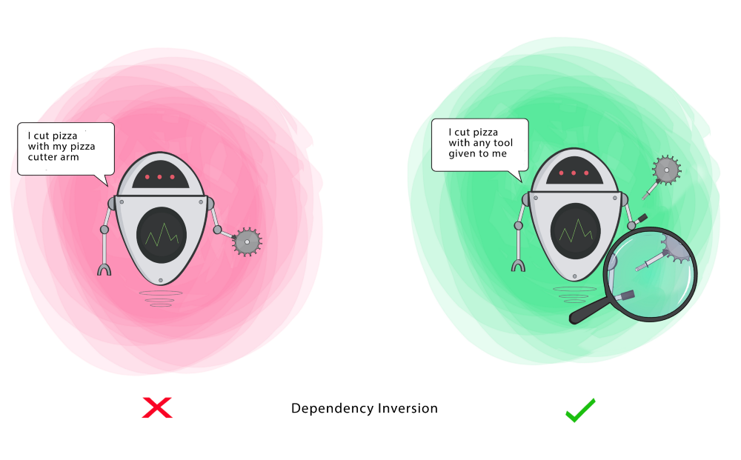
D - Dependency inversion principle
“Entities must depend on abstractions not on concretions. It states that the high-level module must not depend on the low-level module, but they should depend on abstractions.”

Slide 22
Definitions
High-level module (or class): Class that executes an action with a tool
Low-level module (or class): The tool that is needed to execute the action
Abstraction: Represents an interface that connects the two Classes
Details: How the tool works

Slide 23
What’s wrong?
Violates DIP
class PasswordReminder {
private:
MySQLConnection* db_connection;
public:
PasswordReminder(MySQLConnection* db_connection) { this->db_connection = db_connection; }
};
The database connection is dependent on a specific database engine

Slide 24
Let the client choose the engine
class DBConnection {
public:
virtual void connect() = 0;
}; class MySQLConnection: public DBConnection {
public:
virtual void connect() { … }
}; class PasswordReminder {
private:
DBConnection* db_connection;
public:
PasswordReminder(DBConnection* db_connection) { this->db_connection = db_connection; this->db_connection->connect(); }
};

Slide 25

Summary
SOLID principles are universal and serve as a guideline for creating better code (extensible, understandable, maintainable)
The principles are applicable to any type of development methodology
While design patterns sometimes require aspect of the system that are not always available, SOLID principles can be implemented from the first lines of code
Because of the prior reason, SOLID will in practice be more applicable within Agile than some Design Patterns

Slide 26
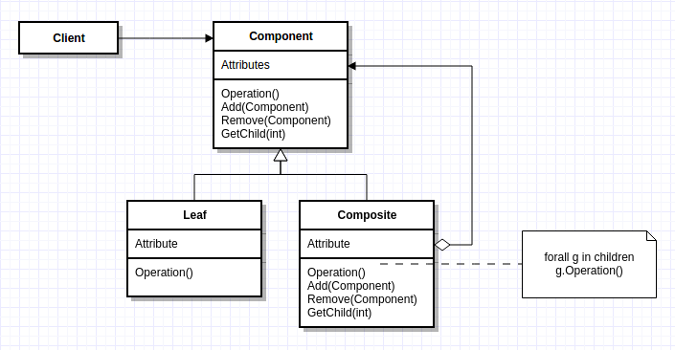
Question
If we follow the original Composite Pattern, which SOLID principle is being violated and how can we fix it?

Slide 27

Acknowledgements
Graphics come from Ugonna Thelma’s article “The S.O.L.I.D Principles in Pictures” https://medium.com/backticks-tildes/the-s-o-l-i-d-principles-in-pictures-b34ce2f1e898
Code examples adapted from scotch.io: https://scotch.io/bar-talk/s-o-l-i-d-the-first-five-principles-of-object-oriented-design
https://web.archive.org/web/20150906155800/http://www.objectmentor.com/resources/articles/Principles_and_Patterns.pdf

Slide 28

Questions?

